Slide 1

The Future of Computer Science Majors

Slide 2

The Growing Demand for Computer Science Talent
377,500 new tech jobs projected annually through 2032 (BLS)
Computing skills increasingly vital across all industries.

Slide 3


AI: Partner, Not Replacement
AI automates routine coding
Requires human creativity & oversight for complex tasks.
Programmers shift focus
Emphasize complex problem-solving & system design.

Slide 4
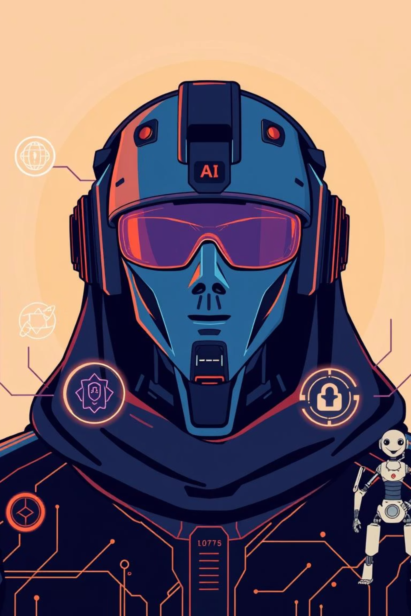
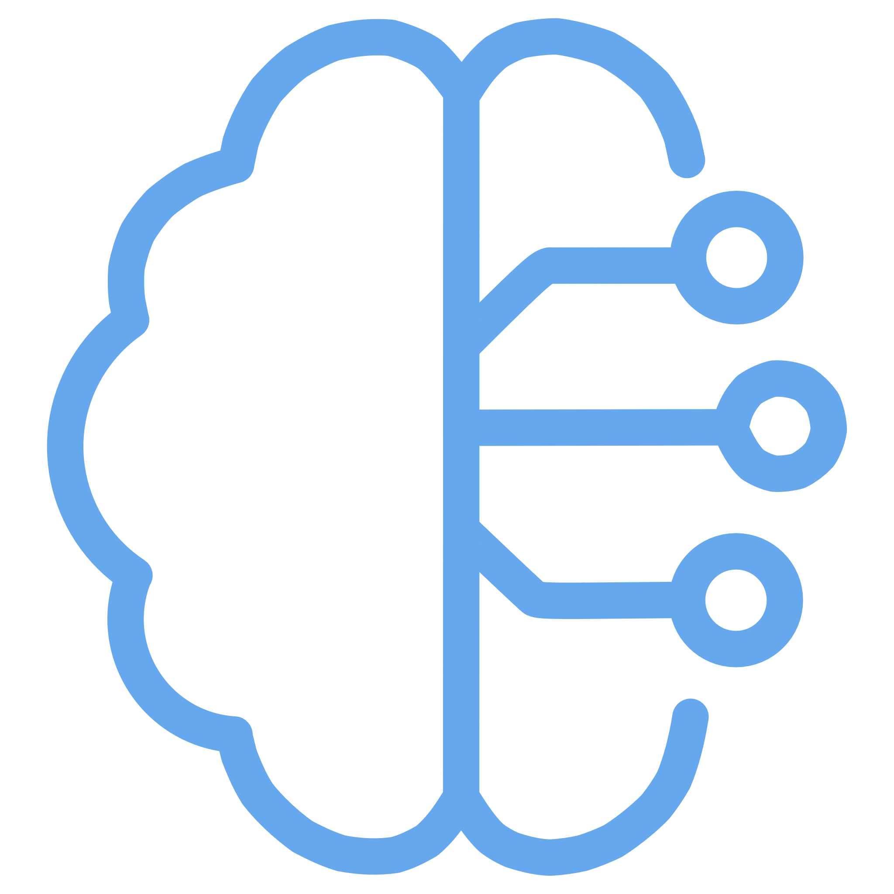


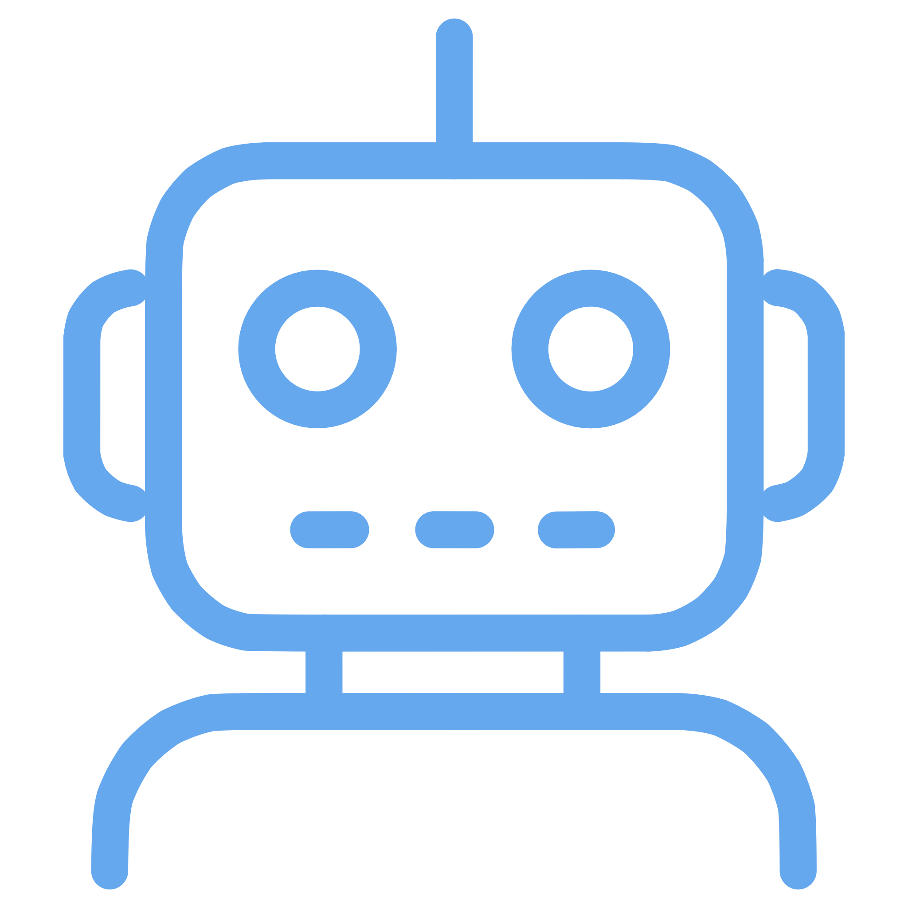
Emerging Tech Shaping the Future
Artificial Intelligence & Machine Learning
Cybersecurity & Data Privacy
Extended Reality (AR/VR)
Robotic Process Automation

Slide 5

Challenges for New Graduates in 2025
Entry-level roles shrinking due to AI & experienced hires
6% unemployment rate among recent CS grads
Proof-of-work projects & internships key to breaking in

Slide 6



Strategic Pathways for Success
01
02
Combine CS with other fields
Develop soft skills
Communication, creativity, ethical reasoning.
Healthcare, finance, or robotics.
03
Embrace lifelong learning
AI tool fluency and continuous adaptation.

Slide 7
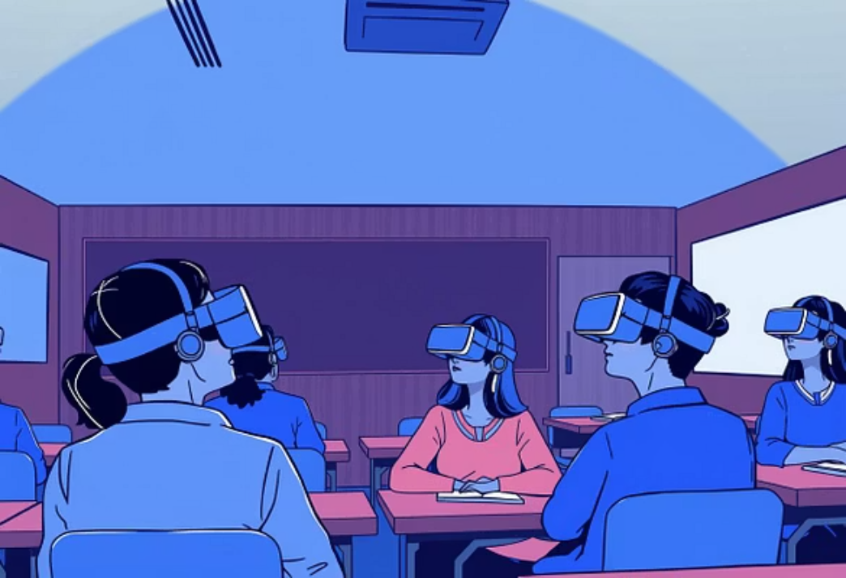
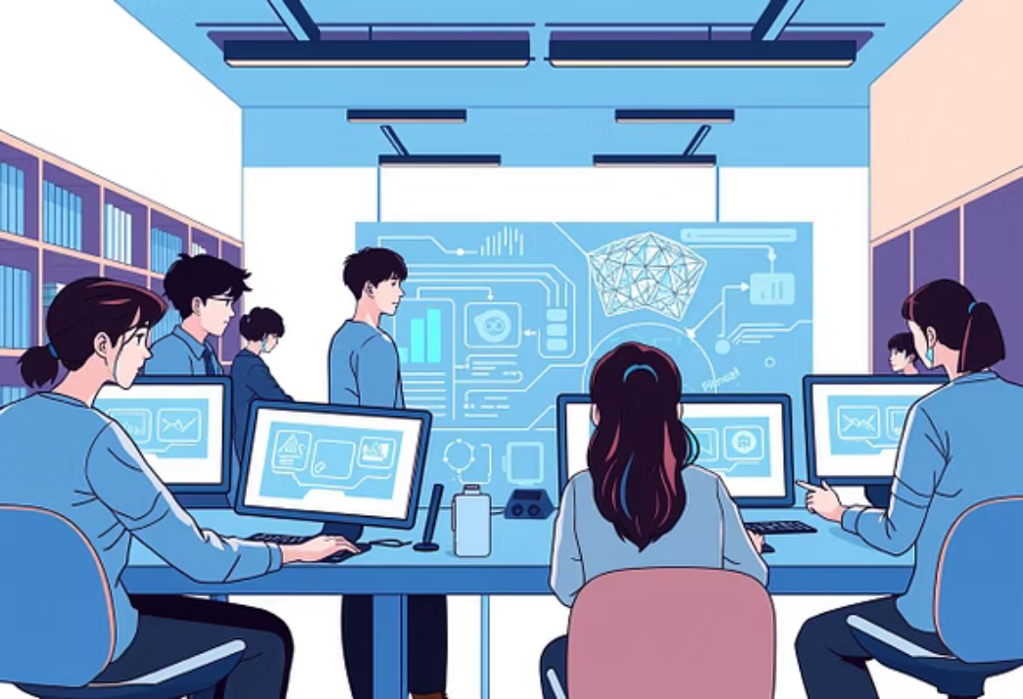

Universities Adapting to the Future
New majors in Data Science, AI, and interdisciplinary studies
Focus on collaboration with AI, not competition
Preparing students for evolving tech landscapes

Slide 8

Your Future in Computer Science Starts Now
High-ROI degree with vast opportunities.
Adaptability & innovation will define tomorrow’s leaders.
Embrace AI as a tool to amplify your impact.

